Slide 1
Unit 4-3 PROVING TRIANGLES CONGRUENT: ASA & AAS
PLANE Geometry

Slide 2
ANGLE-Side-Angle (ASA) Congruence:
If Two Angles and the Included Side of One Triangle are Congruent to Two Angles and the Included Side of Another Triangle, Then the Triangles are Congruent.
$If \overline{AB}≅\overline{XY},∠A≅∠X, and ∠B≅∠Y, then ∆ABC≅∆XYZ$.
$$B$$
$$Y$$
$$A$$
$$C$$
$$Z$$
$$X$$

Slide 3
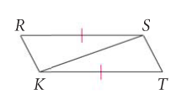
Example 1:
What Information is Missing to Prove the Triangles are Congruent using the ASA Postulate.

Slide 4
Example 2:
Write a Two-Column Proof.
Given: $\overline{AC} bisects ∠BCD, ∠BAC≅∠DAC$
Prove: $∆ABC≅∆ADC$
$$B$$
STATEMENTS | REASONS
$$A$$
$$C$$
$$D$$

Slide 5
Angle-Angle-Side (AAS) Congruence:
If Two Angles and the Nonincluded Side of One Triangle are Congruent to Two Angles and the Nonincluded Side of a Second Triangle, then the Triangles are Congruent.
$If ∠A≅∠X, ∠C≅∠Z,and \overline{AB}≅\overline{XY},then ∆ABC≅∆XYZ$.
$$B$$
$$Y$$
$$A$$
$$C$$
$$Z$$
$$X$$

Slide 6
Example 3:
What Information is Missing to Prove the Triangles are Congruent using the AAS Postulate.
$$J$$
$$K$$
$$L$$
$$M$$
$$P$$

Slide 7
Example 4:
Write a Two-Column Proof.
Given: $\overline{JK}≅\overline{PM},$ $\overline{JK}∥\overline{PM}$
Prove: $∆LMP≅∆LKJ$
$$J$$
$$K$$
STATEMENTS | REASONS
$$L$$
$$M$$
$$P$$

Slide 8
Example 5:
Write a Two-Column Proof.
Given: $\overline{LK} bisects \overline{PM},∠M≅∠P,∠MKL≅∠PKL$
Prove: $∆MKL≅∆PKL$
$$K$$
STATEMENTS | REASONS
$$M$$
$$L$$
$$P$$

Slide 9
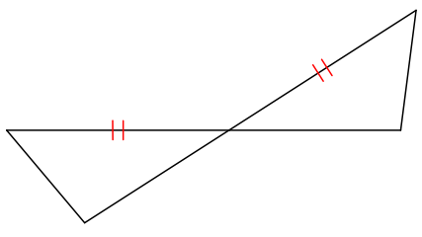
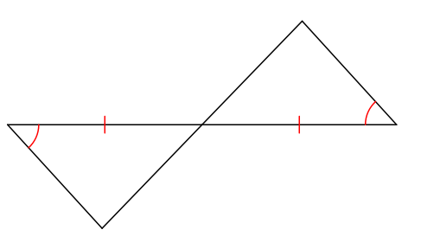
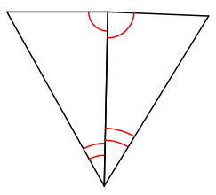
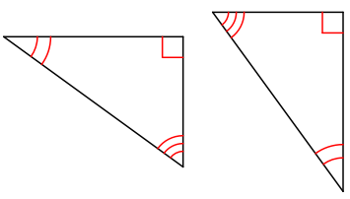
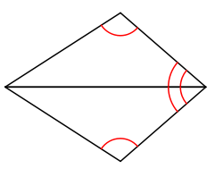
Example 6:
Are the Given Triangles Congruent by AAS, ASA, or Not Possible?

